Slide 1
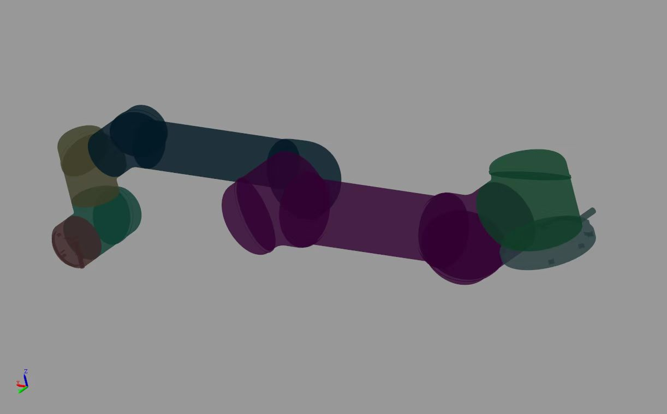














$$X_{3}$$
$$Z_{3}$$
$$X_{2}$$
$$X_{4}$$
$$Z_{2}$$
$$Z_{4}$$
$$X_{1}$$
$$Z_{0}$$
$$X_{5}$$
$$Z_{1}$$
$$Z_{5}$$
$$Z_{6}$$
$$X_{6}$$
$$X_{0}$$

Slide 2



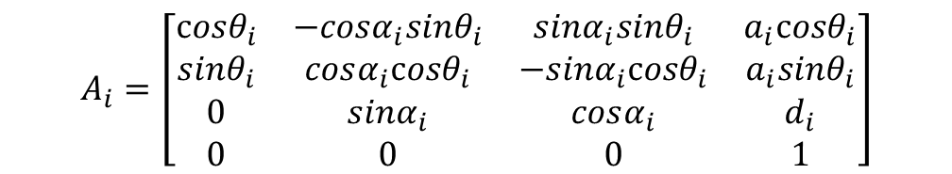


$$i^{R}$$
$$i−1$$
$$i$$
上图中，蓝色的坐标系为$i−1$坐标系，红色的虚线坐标系为$i$坐标系，红色的实线坐标系为$i^{R}$坐标系。
在使用DH方法进行建模时，我们会建立诸如$i−1$坐标系、 $i$坐标系这样的坐标系。虚线坐标系$i$代表的是理想坐标系，是连杆不存在制造、组装误差时的坐标系。实线坐标系$i^{R}$代表实际坐标系，是引入误差后的$i$坐标系。我们使用$A_{i}$代表从$i−1$坐标系变换到$i$坐标系的齐次变换矩阵。当使用标准DH方法时，有:
$$A_{i}=\left[\begin{matrix}cosθ_{i} & −cosα_{i}sinθ_{i} & sinα_{i}sinθ_{i} & a_{i}cosθ_{i} \\ sinθ_{i} & cosα_{i}cosθ_{i} & −sinα_{i}cosθ_{i} & a_{i}sinθ_{i} \\ 0 & sinα_{i} & cosα_{i} & d_{i} \\ 0 & 0 & 0 & 1\end{matrix}\right]$$
从$i$坐标系运动到$i^{R}$坐标系，有两种方法。方法一：使$i$坐标系沿着$i−1$坐标系的三个轴分别运动$dx$、$dy$、$dz$距离，再绕着这三个轴旋转$μx$、$μy$、$μz$弧度。这里的六个量都是微量，因此满足以下的等式：
$$A_{i^{R}}=\left[\begin{matrix}1 & −μz & μy & dx \\ μz & 1 & −μx & dy \\ −μy & μx & 1 & dz \\ 0 & 0 & 0 & 1\end{matrix}\right]∙A_{i}$$

Slide 3


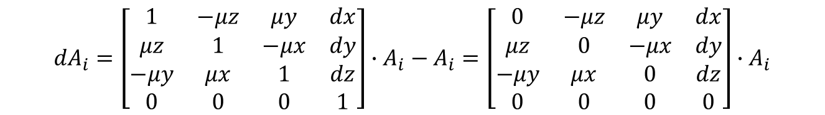
我们令：
$${dA}_{i}=A_{i^{R}}−A_{i}$$
则有：
$${dA}_{i}=\left[\begin{matrix}1 & −μz & μy & dx \\ μz & 1 & −μx & dy \\ −μy & μx & 1 & dz \\ 0 & 0 & 0 & 1\end{matrix}\right]∙A_{i}−A_{i}=\left[\begin{matrix}0 & −μz & μy & dx \\ μz & 0 & −μx & dy \\ −μy & μx & 0 & dz \\ 0 & 0 & 0 & 0\end{matrix}\right]∙A_{i}$$
令：
$$∆^{i−1}=\left[\begin{matrix}0 & −μz & μy & dx \\ μz & 0 & −μx & dy \\ −μy & μx & 0 & dz \\ 0 & 0 & 0 & 0\end{matrix}\right]$$
$∆^{i−1}$的上标代表其内部的六个微分量都是相对于$i−1$坐标系定义的。那么上式即可写为：
$${dA}_{i}=∆^{i−1}∙A_{i}$$
方法二：使$i$坐标系沿着$i$坐标系的三个轴分别运动$dx$、$dy$、$dz$距离，再绕着这三个轴旋转$μx$、$μy$、$μz$弧度。这时候方法一中左乘的规则变为了右乘，这里直接给出结论：
$${dA}_{i}=A_{i}∙∆^{i}$$

Slide 4
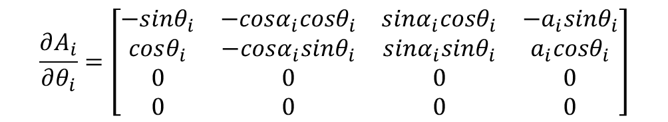



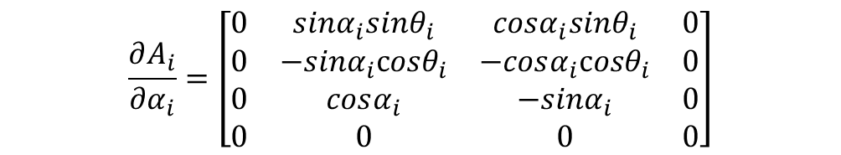
根据微分理论：
$${dA}_{i}=\frac{∂A_{i}}{∂θ_{i}}{δθ}_{i}+\frac{∂A_{i}}{∂α_{i}}{δα}_{i}+\frac{∂A_{i}}{∂d_{i}}{δd}_{i}+\frac{∂A_{i}}{∂a_{i}}{δa}_{i}$$
$$\frac{∂A_{i}}{∂θ_{i}}=\left[\begin{matrix}−sinθ_{i} & −cosα_{i}cosθ_{i} & sinα_{i}cosθ_{i} & {−a}_{i}sinθ_{i} \\ cosθ_{i} & −cosα_{i}sinθ_{i} & sinα_{i}sinθ_{i} & a_{i}cosθ_{i} \\ 0 & 0 & 0 & 0 \\ 0 & 0 & 0 & 0\end{matrix}\right]$$
$$\frac{∂A_{i}}{∂α_{i}}=\left[\begin{matrix}0 & sinα_{i}sinθ_{i} & cosα_{i}sinθ_{i} & 0 \\ 0 & −sinα_{i}cosθ_{i} & −cosα_{i}cosθ_{i} & 0 \\ 0 & cosα_{i} & −sinα_{i} & 0 \\ 0 & 0 & 0 & 0\end{matrix}\right]$$
$$\frac{∂A_{i}}{∂d_{i}}=\left[\begin{matrix}0 & 0 & 0 & 0 \\ 0 & 0 & 0 & 0 \\ 0 & 0 & 0 & 1 \\ 0 & 0 & 0 & 0\end{matrix}\right]$$
$$\frac{∂A_{i}}{∂a_{i}}=\left[\begin{matrix}0 & 0 & 0 & cosθ_{i} \\ 0 & 0 & 0 & sinθ_{i} \\ 0 & 0 & 0 & 0 \\ 0 & 0 & 0 & 0\end{matrix}\right]$$
按照之前的第一种方法：
$${dA}_{i}=∆^{i−1}∙A_{i}$$

Slide 5

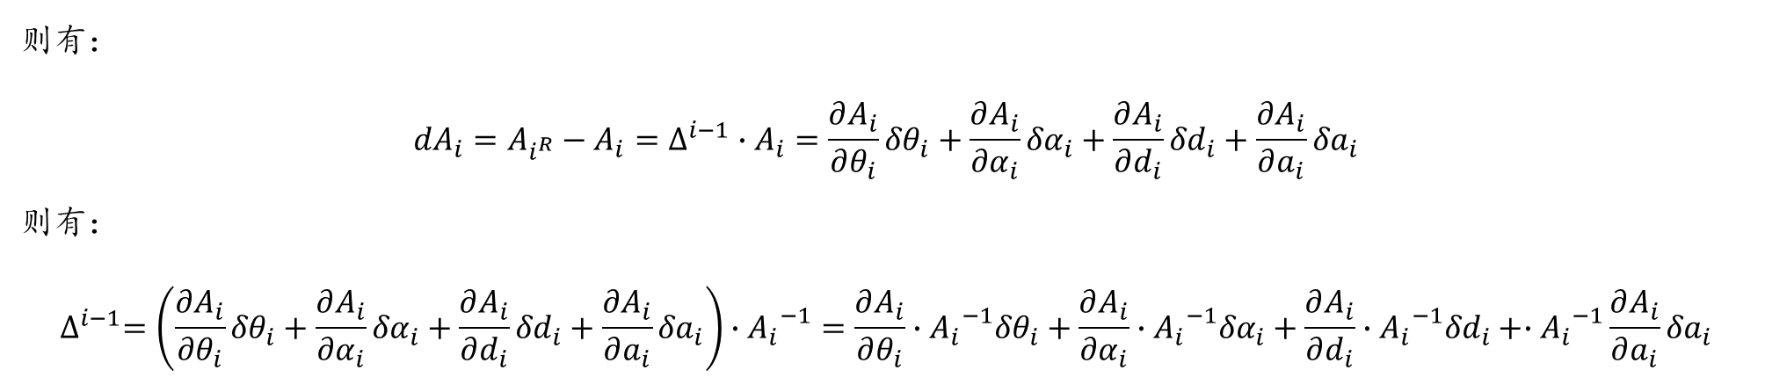
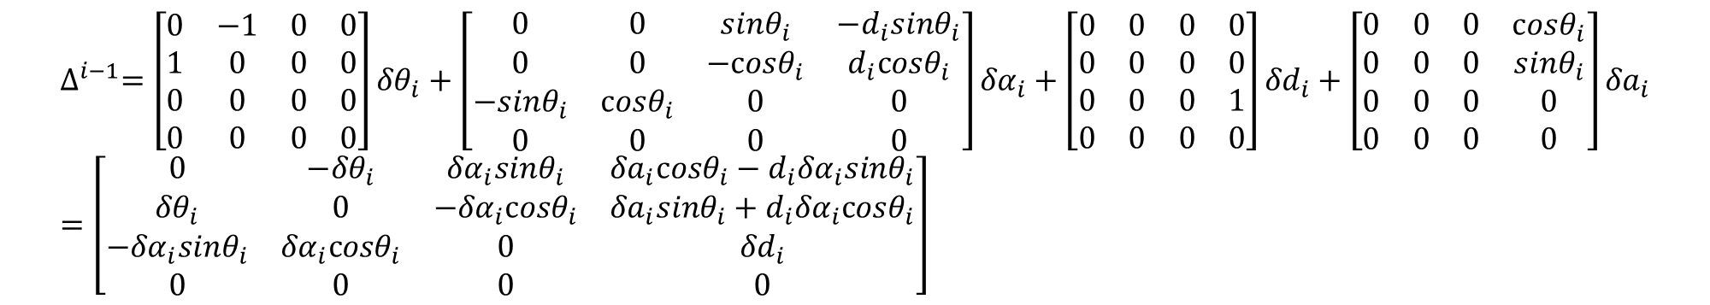
则有：
$${dA}_{i}=A_{i^{R}}−A_{i}=∆^{i−1}∙A_{i}=\frac{∂A_{i}}{∂θ_{i}}{δθ}_{i}+\frac{∂A_{i}}{∂α_{i}}{δα}_{i}+\frac{∂A_{i}}{∂d_{i}}{δd}_{i}+\frac{∂A_{i}}{∂a_{i}}{δa}_{i}$$
则有：
$$∆^{i−1}=\left(\frac{∂A_{i}}{∂θ_{i}}{δθ}_{i}+\frac{∂A_{i}}{∂α_{i}}{δα}_{i}+\frac{∂A_{i}}{∂d_{i}}{δd}_{i}+\frac{∂A_{i}}{∂a_{i}}{δa}_{i}\right)∙{A_{i}}^{−1}=\frac{∂A_{i}}{∂θ_{i}}∙{A_{i}}^{−1}{δθ}_{i}+\frac{∂A_{i}}{∂α_{i}}∙{A_{i}}^{−1}{δα}_{i}+\frac{∂A_{i}}{∂d_{i}}∙{A_{i}}^{−1}{δd}_{i}+∙{A_{i}}^{−1}\frac{∂A_{i}}{∂a_{i}}{δa}_{i}$$
而：
$${A_{i}}^{−1}=\left[\begin{matrix}cosθ_{i} & sinθ_{i} & 0 & {−a}_{i} \\ −cosα_{i}sinθ_{i} & cosα_{i}cosθ_{i} & sinα_{i} & −d_{i}sinα_{i} \\ sinα_{i}sinθ_{i} & −sinα_{i}cosθ_{i} & cosα_{i} & {−d}_{i}cosα_{i} \\ 0 & 0 & 0 & 1\end{matrix}\right]$$
所以：
$$∆^{i−1}=\left[\begin{matrix}0 & −1 & 0 & 0 \\ 1 & 0 & 0 & 0 \\ 0 & 0 & 0 & 0 \\ 0 & 0 & 0 & 0\end{matrix}\right]{δθ}_{i}+\left[\begin{matrix}0 & 0 & sinθ_{i} & −d_{i}sinθ_{i} \\ 0 & 0 & −cosθ_{i} & d_{i}cosθ_{i} \\ −sinθ_{i} & cosθ_{i} & 0 & 0 \\ 0 & 0 & 0 & 0\end{matrix}\right]{δα}_{i}+\left[\begin{matrix}0 & 0 & 0 & 0 \\ 0 & 0 & 0 & 0 \\ 0 & 0 & 0 & 1 \\ 0 & 0 & 0 & 0\end{matrix}\right]{δd}_{i}+\left[\begin{matrix}0 & 0 & 0 & cosθ_{i} \\ 0 & 0 & 0 & sinθ_{i} \\ 0 & 0 & 0 & 0 \\ 0 & 0 & 0 & 0\end{matrix}\right]{δa}_{i}=\left[\begin{matrix}0 & −{δθ}_{i} & {δα}_{i}sinθ_{i} & {δa}_{i}cosθ_{i}−d_{i}{δα}_{i}sinθ_{i} \\ {δθ}_{i} & 0 & −{δα}_{i}cosθ_{i} & {δa}_{i}sinθ_{i}+d_{i}{δα}_{i}cosθ_{i} \\ {−δα}_{i}sinθ_{i} & {δα}_{i}cosθ_{i} & 0 & {δd}_{i} \\ 0 & 0 & 0 & 0\end{matrix}\right]$$

Slide 6
我们以六轴机械臂为例：
$$T_{6^{R}}^{0}=T_{6}^{0}+dT_{6}^{0}=A_{1^{R}}∙A_{2^{R}}∙A_{3^{R}}∙A_{4^{R}}∙A_{5^{R}}∙A_{6^{R}}=\left(A_{1}+{dA}_{1}\right)\left(A_{2}+{dA}_{2}\right)⋯\left(A_{6}+{dA}_{6}\right)=\prod_{i=1}^{6}{\left(A_{i}+{dA}_{i}\right)}$$
上式展开,省略二阶及更高项后，可得：
$$T_{6^{R}}^{0}=T_{6}^{0}+dT_{6}^{0}=A_{1}A_{2}A_{3}A_{4}A_{5}A_{6}+\sum_{i=1}^{6}{\left(A_{1}{⋯A_{i−1}dA}_{i}A_{i+1}⋯A_{6}\right)}$$
将${dA}_{i}=∆^{i−1}∙A_{i}$带入上式后，可得：
$$T_{6^{R}}^{0}=T_{6}^{0}+dT_{6}^{0}=A_{1}A_{2}A_{3}A_{4}A_{5}A_{6}+\sum_{i=1}^{6}{\left(A_{1}⋯A_{i−1}∙∆^{i−1}∙A_{i}A_{i+1}⋯A_{6}\right)}=T_{6}^{0}+\sum_{i=1}^{6}{\left(T_{i−1}^{0}{∙∆}^{i−1}∙{T_{i−1}^{0}}^{−1}∙T_{6}^{0}\right)}$$
所以：
$$dT_{6}^{0}=\sum_{i=1}^{6}{\left(T_{i−1}^{0}{∙∆}^{i−1}∙{T_{i−1}^{0}}^{−1}∙T_{6}^{0}\right)}=\sum_{i=1}^{6}{\left(T_{i−1}^{0}{∙∆}^{i−1}∙{T_{i−1}^{0}}^{−1}\right)}∙T_{6}^{0}$$
而$T_{i−1}^{0}{∙∆}^{i−1}∙{T_{i−1}^{0}}^{−1}$代表的是那六个微分量从$i−1$坐标系转换到基坐标系后的表示，其结果也是反对称阵。

Slide 7

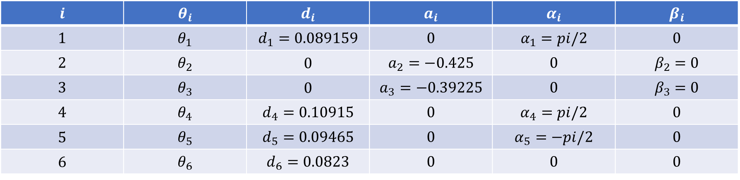
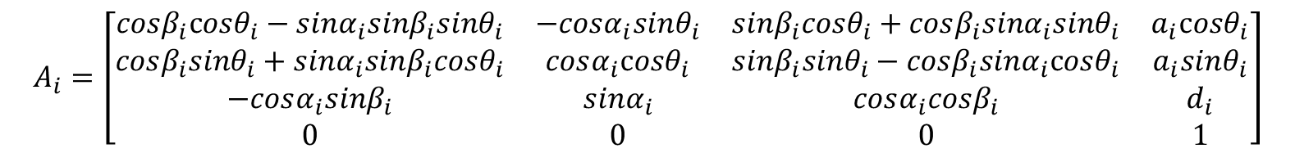
DH参数表：
$$i$$ | $$θ_{i}$$ | $$d_{i}$$ | $$a_{i}$$ | $$α_{i}$$ | $$β_{i}$$
$$1$$ | $$θ_{1}$$ | $$d_{1}=0.089159$$ | $$0$$ | $$α_{1}=pi/2$$ | $$0$$
$$2$$ | $$θ_{2}$$ | 0 | $$a_{2}=−0.425$$ | $$0$$ | $$β_{2}=0$$
$$3$$ | $$θ_{3}$$ | 0 | $$a_{3}=−0.39225$$ | $$0$$ | $$β_{3}=0$$
$$4$$ | $$θ_{4}$$ | $$d_{4}=0.10915$$ | $$0$$ | $$α_{4}=pi/2$$ | $$0$$
5 | $$θ_{5}$$ | $$d_{5}=0.09465$$ | $$0$$ | $$α_{5}=−pi/2$$ | $$0$$
6 | $$θ_{6}$$ | $$d_{6}=0.0823$$ | $$0$$ | $$0$$ | $$0$$
齐次变换矩阵：
$$A_{i}=\left[\begin{matrix}cosβ_{i}cosθ_{i}−sinα_{i}sinβ_{i}sinθ_{i} & −cosα_{i}sinθ_{i} & sinβ_{i}cosθ_{i}+cosβ_{i}sinα_{i}sinθ_{i} & a_{i}cosθ_{i} \\ cosβ_{i}sinθ_{i}+sinα_{i}sinβ_{i}cosθ_{i} & cosα_{i}cosθ_{i} & sinβ_{i}sinθ_{i}−cosβ_{i}sinα_{i}cosθ_{i} & a_{i}sinθ_{i} \\ −cosα_{i}sinβ_{i} & sinα_{i} & cosα_{i}cosβ_{i} & d_{i} \\ 0 & 0 & 0 & 1\end{matrix}\right]$$
根据微分理论：
$${dA}_{i}=\frac{∂A_{i}}{∂θ_{i}}{δθ}_{i}+\frac{∂A_{i}}{∂d_{i}}{δd}_{i}+\frac{∂A_{i}}{∂a_{i}}{δa}_{i}+\frac{∂A_{i}}{∂α_{i}}{δα}_{i}+\frac{∂A_{i}}{∂β_{i}}{δβ}_{i}$$

Slide 8
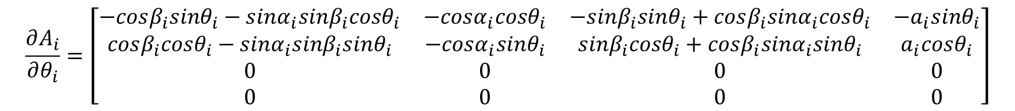
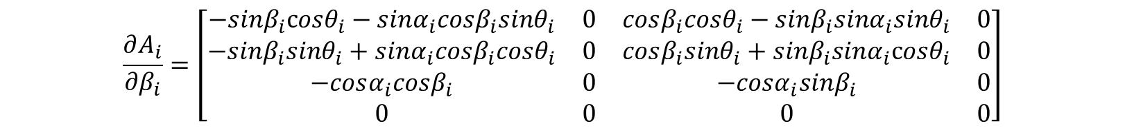
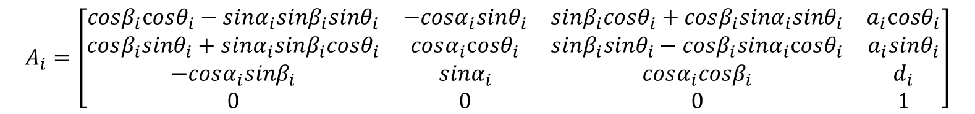


$$A_{i}=\left[\begin{matrix}cosβ_{i}cosθ_{i}−sinα_{i}sinβ_{i}sinθ_{i} & −cosα_{i}sinθ_{i} & sinβ_{i}cosθ_{i}+cosβ_{i}sinα_{i}sinθ_{i} & a_{i}cosθ_{i} \\ cosβ_{i}sinθ_{i}+sinα_{i}sinβ_{i}cosθ_{i} & cosα_{i}cosθ_{i} & sinβ_{i}sinθ_{i}−cosβ_{i}sinα_{i}cosθ_{i} & a_{i}sinθ_{i} \\ −cosα_{i}sinβ_{i} & sinα_{i} & cosα_{i}cosβ_{i} & d_{i} \\ 0 & 0 & 0 & 1\end{matrix}\right]$$
$$\frac{∂A_{i}}{∂θ_{i}}=\left[\begin{matrix}−cosβ_{i}sinθ_{i}−sinα_{i}sinβ_{i}cosθ_{i} & −cosα_{i}cosθ_{i} & −sinβ_{i}sinθ_{i}+cosβ_{i}sinα_{i}cosθ_{i} & {−a}_{i}sinθ_{i} \\ cosβ_{i}cosθ_{i}−sinα_{i}sinβ_{i}sinθ_{i} & −cosα_{i}sinθ_{i} & sinβ_{i}cosθ_{i}+cosβ_{i}sinα_{i}sinθ_{i} & a_{i}cosθ_{i} \\ 0 & 0 & 0 & 0 \\ 0 & 0 & 0 & 0\end{matrix}\right]$$
$$\frac{∂A_{i}}{∂d_{i}}=\left[\begin{matrix}0 & 0 & 0 & 0 \\ 0 & 0 & 0 & 0 \\ 0 & 0 & 0 & 1 \\ 0 & 0 & 0 & 0\end{matrix}\right]$$
$$\frac{∂A_{i}}{∂a_{i}}=\left[\begin{matrix}0 & 0 & 0 & cosθ_{i} \\ 0 & 0 & 0 & sinθ_{i} \\ 0 & 0 & 0 & 0 \\ 0 & 0 & 0 & 0\end{matrix}\right]$$
$$\frac{∂A_{i}}{∂α_{i}}=\left[\begin{matrix}−cosα_{i}sinβ_{i}sinθ_{i} & sinα_{i}sinθ_{i} & cosβ_{i}cosα_{i}sinθ_{i} & 0 \\ cosα_{i}sinβ_{i}cosθ_{i} & −sinα_{i}cosθ_{i} & −cosβ_{i}cosα_{i}cosθ_{i} & 0 \\ sinα_{i}sinβ_{i} & cosα_{i} & −sinα_{i}cosβ_{i} & 0 \\ 0 & 0 & 0 & 0\end{matrix}\right]$$
$$\frac{∂A_{i}}{∂β_{i}}=\left[\begin{matrix}−sinβ_{i}cosθ_{i}−sinα_{i}cosβ_{i}sinθ_{i} & 0 & cosβ_{i}cosθ_{i}−sinβ_{i}sinα_{i}sinθ_{i} & 0 \\ −sinβ_{i}sinθ_{i}+sinα_{i}cosβ_{i}cosθ_{i} & 0 & cosβ_{i}sinθ_{i}+sinβ_{i}sinα_{i}cosθ_{i} & 0 \\ −cosα_{i}cosβ_{i} & 0 & −cosα_{i}sinβ_{i} & 0 \\ 0 & 0 & 0 & 0\end{matrix}\right]$$

Slide 9
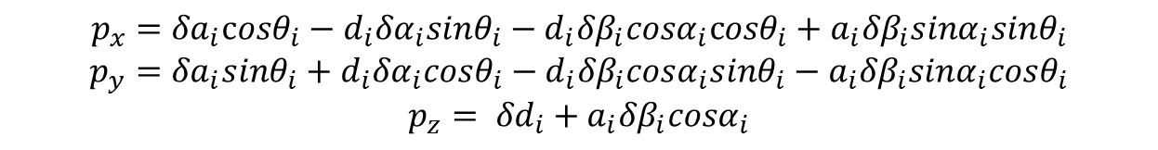
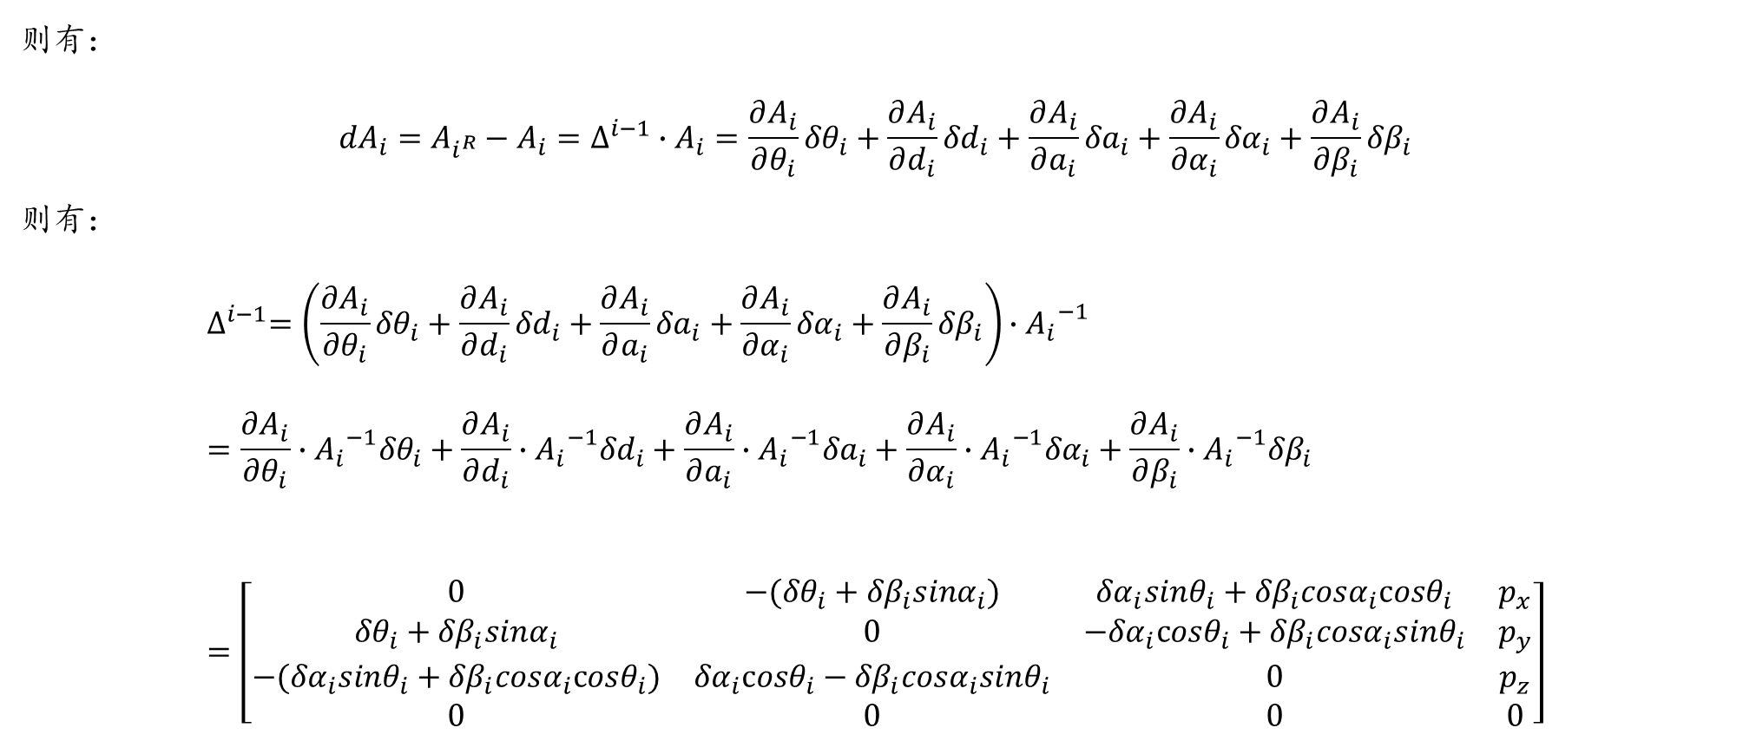
则有：
$${dA}_{i}=A_{i^{R}}−A_{i}=∆^{i−1}∙A_{i}=\frac{∂A_{i}}{∂θ_{i}}{δθ}_{i}+\frac{∂A_{i}}{∂d_{i}}{δd}_{i}+\frac{∂A_{i}}{∂a_{i}}{δa}_{i}+\frac{∂A_{i}}{∂α_{i}}{δα}_{i}+\frac{∂A_{i}}{∂β_{i}}{δβ}_{i}$$
则有：
$$∆^{i−1}=\left(\frac{∂A_{i}}{∂θ_{i}}{δθ}_{i}+\frac{∂A_{i}}{∂d_{i}}{δd}_{i}+\frac{∂A_{i}}{∂a_{i}}{δa}_{i}+\frac{∂A_{i}}{∂α_{i}}{δα}_{i}+\frac{∂A_{i}}{∂β_{i}}{δβ}_{i}\right)∙{A_{i}}^{−1}=\frac{∂A_{i}}{∂θ_{i}}∙{A_{i}}^{−1}{δθ}_{i}+\frac{∂A_{i}}{∂d_{i}}∙{A_{i}}^{−1}{δd}_{i}+\frac{∂A_{i}}{∂a_{i}}∙{A_{i}}^{−1}{δa}_{i}+\frac{∂A_{i}}{∂α_{i}}∙{A_{i}}^{−1}{δα}_{i}+\frac{∂A_{i}}{∂β_{i}}∙{A_{i}}^{−1}{δβ}_{i}=\left[\begin{matrix}0 & −({δθ}_{i}+{δβ}_{i}sinα_{i}) & {δα}_{i}sinθ_{i}+{δβ}_{i}cosα_{i}cosθ_{i} & p_{x} \\ {δθ}_{i}+{δβ}_{i}sinα_{i} & 0 & {−δα}_{i}cosθ_{i}+{δβ}_{i}cosα_{i}sinθ_{i} & p_{y} \\ −({δα}_{i}sinθ_{i}+{δβ}_{i}cosα_{i}cosθ_{i}) & {δα}_{i}cosθ_{i}−{δβ}_{i}cosα_{i}sinθ_{i} & 0 & p_{z} \\ 0 & 0 & 0 & 0\end{matrix}\right]$$
$$p_{x}={δa}_{i}cosθ_{i}−d_{i}{δα}_{i}sinθ_{i}−d_{i}{δβ}_{i}cosα_{i}cosθ_{i}+a_{i}{δβ}_{i}sinα_{i}sinθ_{i}$$
$$p_{y}={δa}_{i}sinθ_{i}+d_{i}{δα}_{i}cosθ_{i}−d_{i}{δβ}_{i}cosα_{i}sinθ_{i}−a_{i}{δβ}_{i}sinα_{i}cosθ_{i}$$
$$p_{z}= {δd}_{i}+a_{i}{δβ}_{i}cosα_{i}$$

Slide 10
$$dT_{6}^{0}=\sum_{i=1}^{6}{\left(T_{i−1}^{0}{∙∆}^{i−1}∙{T_{i−1}^{0}}^{−1}∙T_{6}^{0}\right)}=\sum_{i=1}^{6}{\left(T_{i−1}^{0}{∙∆}^{i−1}∙{T_{i−1}^{0}}^{−1}\right)}∙T_{6}^{0}$$

